Slide 1

November 2023
Load Prediction using machine learning in python
Utilizing Structure as Force Transducer to Predict applied Load Using Strain as input
Aditya panigrahi, Brandon Cruz, Spenser Stark
The Data Wizards G06, The University of Texas at Austin

Slide 2
Introduction
Background
Python Modules Used
Code
Demonstration
Results
Conclusion

Slide 3
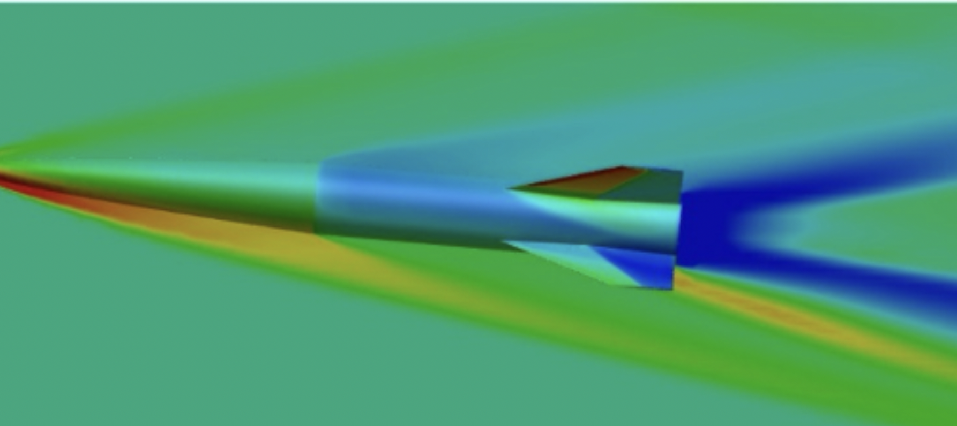

Background
Problem:
Traditionally, input forces are directly measured using load cells. However, in many instances, direct load measurement is either impossible or inaccurate, especially for vehicles moving at high speeds like hypersonic missiles.
Solution:
In the linear elastic case, a set of loads will uniquely deform a structure; this deformation can be measured using strain. By using these unique strains as input, an ML code can be created that predicts loads based on strain.
https://fast.ae.utexas.edu/

Slide 4
Work Delegation
Brandon
User interface and plotting
Aditya
Load Prediction algorithm
Spenser
Temperature Difference algorithm

Slide 5





Modules Used
PyQt
Numpy
Pandas
Matplotlib
Seaborn

Slide 6
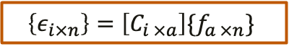


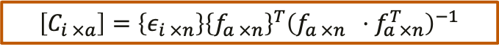
Prediction Model
$ε: Strain$
$f:Point load$
$C: Flexibility Coefficient Matrix$
$i: Sensor Number$ (1-32)
$a: Point Load$ (1-4)
$n: Number of Load cases$
Training
$$\left\{ε_{i×n}\right\}=\left[C_{i ×a}\right]\{f_{a ×n}\}$$
$\left[C_{i ×a}\right]=\left\{ε_{i ×n}\right\}{\left\{f_{a ×n}\right\}}^{T}{\left(f_{a ×n} ⋅f_{a ×n}^{T}\right)}^{−1}$
Pseudo-Inverse Model
$$\left\{f_{p}\right\}=\left(C^{T}⋅C\right)⋅C^{T}\left\{ε\right\}={\left[C\right]}^{+}\left\{ε\right\}$$

Slide 7

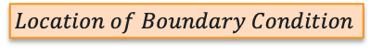
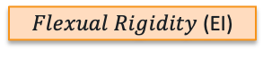
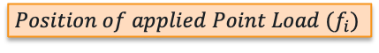
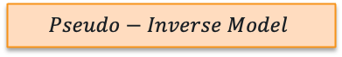
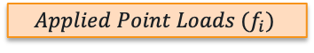
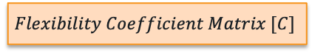
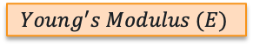
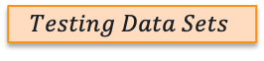
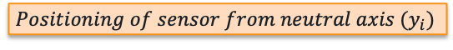
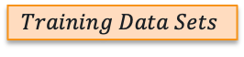
Data Flow
Strain Calculation
$$Euler−Bernoulli Beam Equation$$
Structure
$Flexual Rigidity$ (EI)
$$Training Data Sets$$
$$Testing Data Sets$$
$$Young^{′}s Modulus (E)$$
$$Location of Boundary Condition$$
$$Flexibility Coefficient Matrix [C]$$
$$Positioning of sensor from neutral axis (y_{i})$$
$$Positioning of sensors from Boundary Condititon(y_{i})$$
Load Condition
Load Prediction
$$Applied Point Loads (f_{i})$$
$$Pseudo−Inverse Model$$
$$Position of applied Point Load (f_{i})$$

Slide 8
Features
GUI for inputting key parameters
Ability to generate thousands of training and testing data with a click of a button
Access the sensitivity of the prediction model using a heat map plot
Ability to add noise level to the testing data
Informative plots that enable the user to evaluate the performance of the prediction model
Validation Cases
Test cases with No-Noise Level
Test cases with Noise-Level
A look into the effect of a range of noise levels in the input data on the load prediction.
Thermal Load prediction (discussed later)
Uses the same approach as the load prediction, but now the thermal strain is used as input along with bending strain.

Slide 9
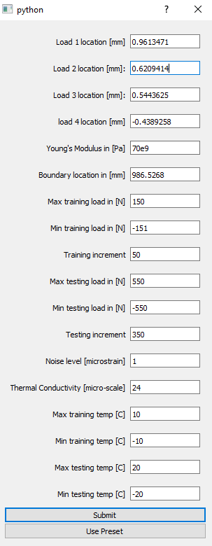
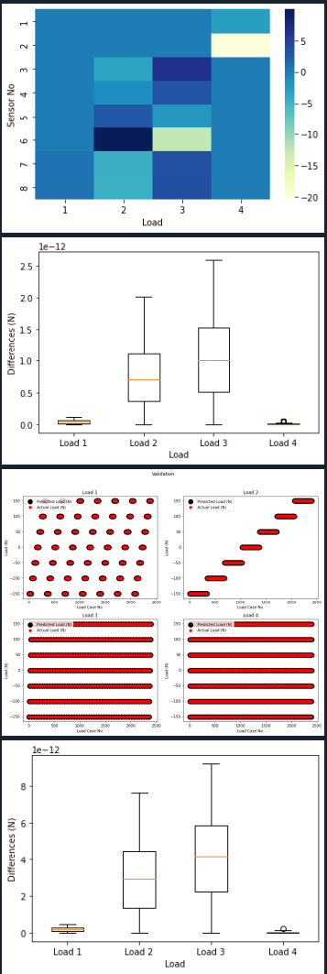
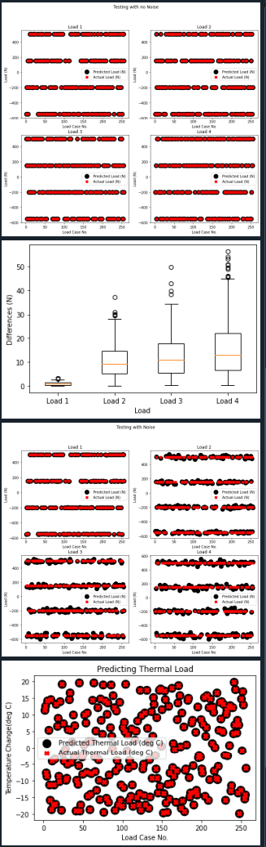
GUI
PyQt GUI assigns user input to corresponding variables.
Fills entry boxes with preset on button click.
One click solution for initiating training and testing process.

Slide 10
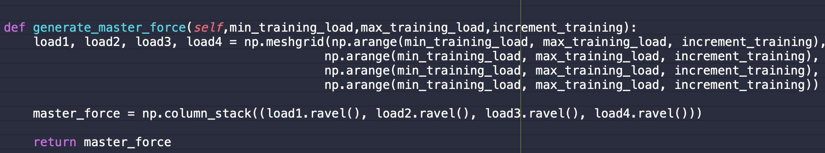
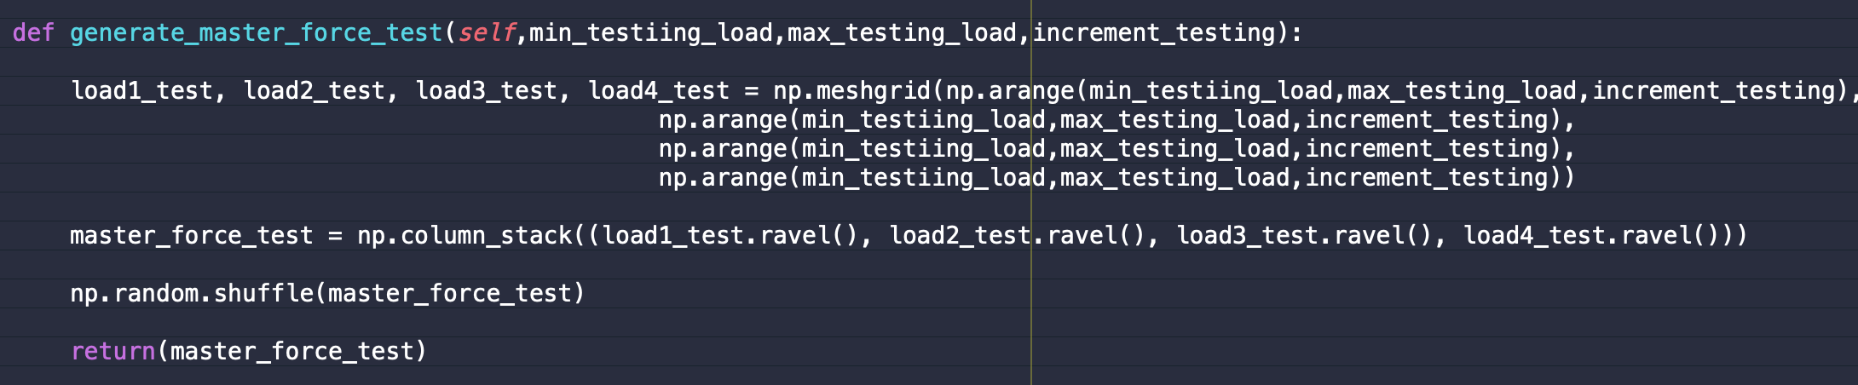
Generating Training and Testing Data
Training Data
Testing Data

Slide 11
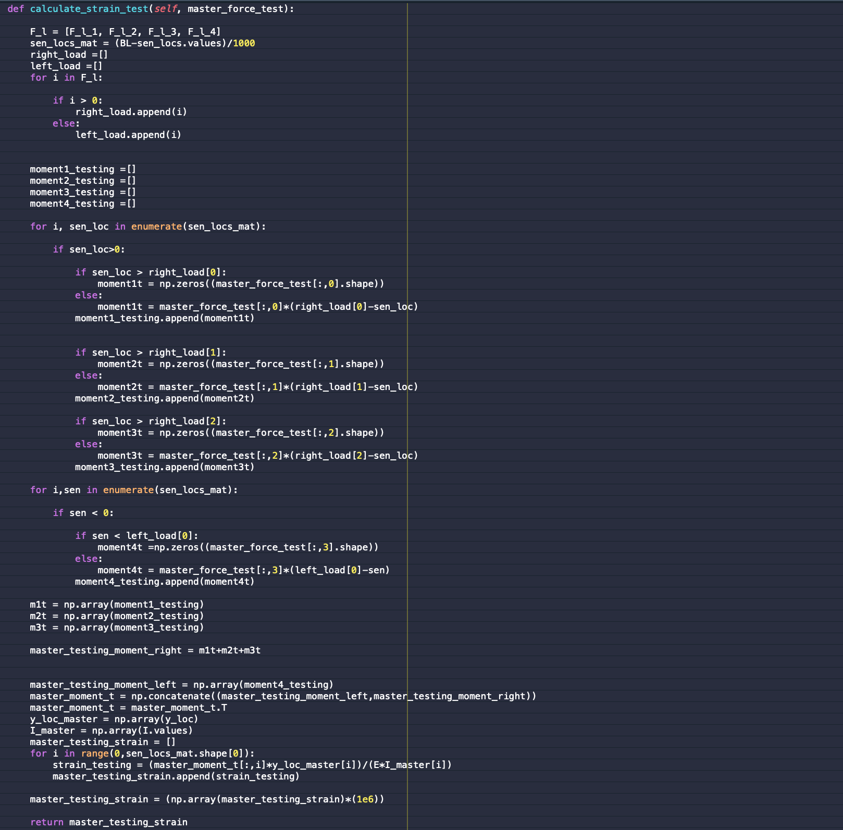

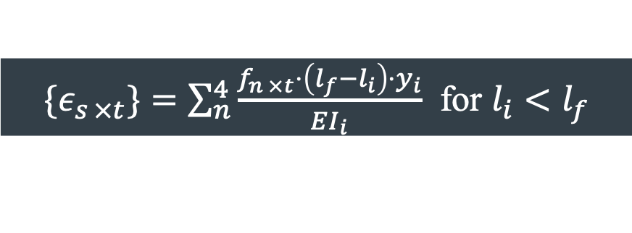
Calculating Strain using Euler-Bernoulli Beam Equation
${\{ε}_{s ×t}\}=\sum_{n}^{4}{\frac{f_{n ×t}⋅\left(l_{f}−l_{i}\right)⋅y_{i}}{EI_{i}}}$ for $l_{i}<l_{f}$
$t :Number of training or testing set$
$y_{i}:Vertical Distance between neutral axis and sensor location$
$EI_{i}:Flexural Rigidity$
$l_{i} :axial position of sensors with respect to fixed boundary condition$
$l_{f} :axial position of point loads with respect to fixed boundary condition$

Slide 12
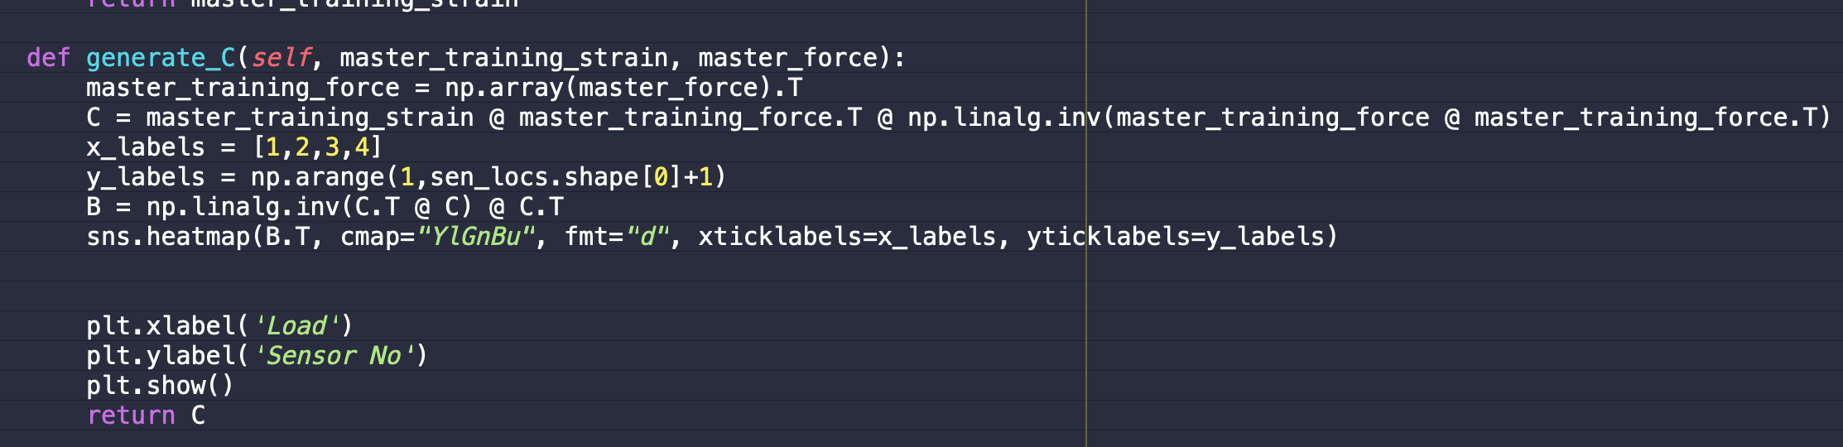
Determining Flexibility Coefficient Matrix and Prediction Model

Slide 13
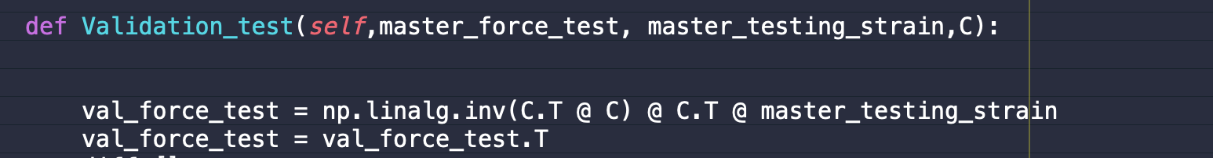
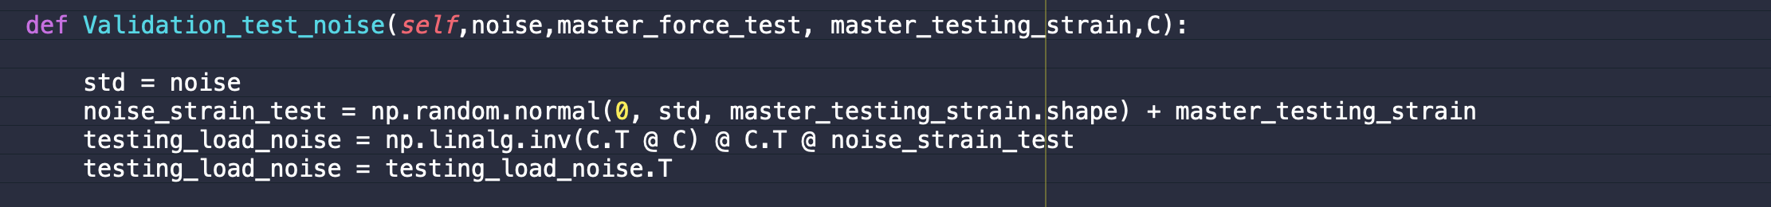
Testing the Prediction Model
No-Noise Case
Noise Case

Slide 14
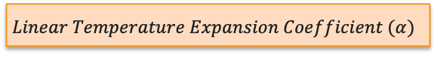
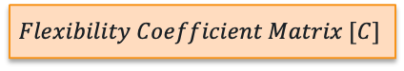
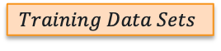

Data Flow for Thermal Load Prediction
Strain Calculation
$$Euler−Bernoulli Beam Equation$$
Structure
Load Condition
$$Training Data Sets$$
$$Testing Data Sets$$
$$Flexibility Coefficient Matrix [C]$$
Thermal Load Condition
$$Linear Temperature Expansion Coefficient (α)$$
Load Prediction
$$Uniform Temperature Change (ΔT)$$
$$Pseudo−Inverse Model$$

Slide 15
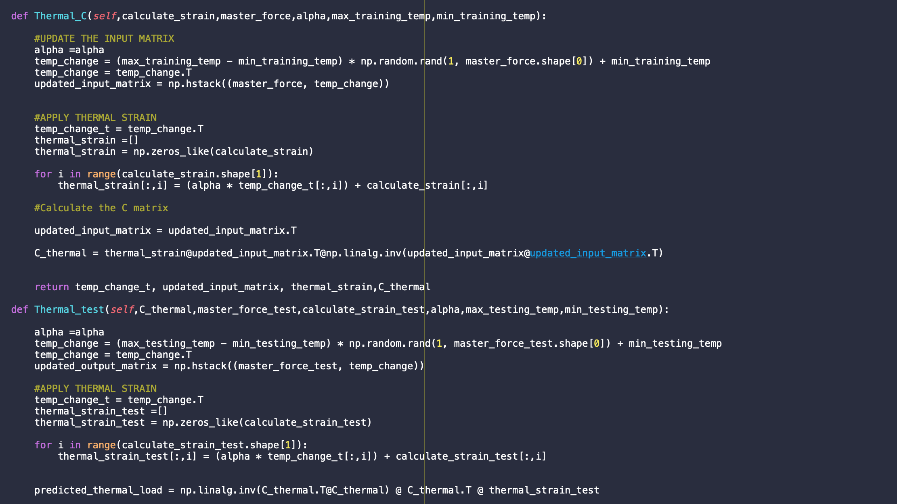
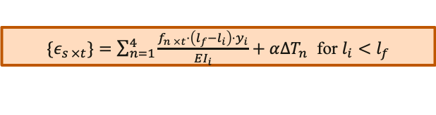
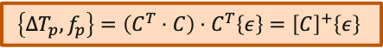
Thermal Load Prediction
${\{ε}_{s ×t}\}=\sum_{n=1}^{4}{\frac{f_{n ×t}⋅\left(l_{f}−l_{i}\right)⋅y_{i}}{EI_{i}}}+αΔT_{n}$ for $l_{i}<l_{f}$
$\left[C_{i ×a}\right]=\left\{ε_{i ×n}\right\}{\left\{{ΔT_{1×n},f}_{a ×n}\right\}}^{T}{\left(({ΔT_{1×n},f}_{a ×n}) ⋅{{(ΔT_{1×n},f}_{a ×n})}^{T} \right)}^{−1}$
$$\left\{{ΔT}_{p},f_{p}\right\}=\left(C^{T}⋅C\right)⋅C^{T}\left\{ε\right\}={\left[C\right]}^{+}\left\{ε\right\}$$

Slide 16
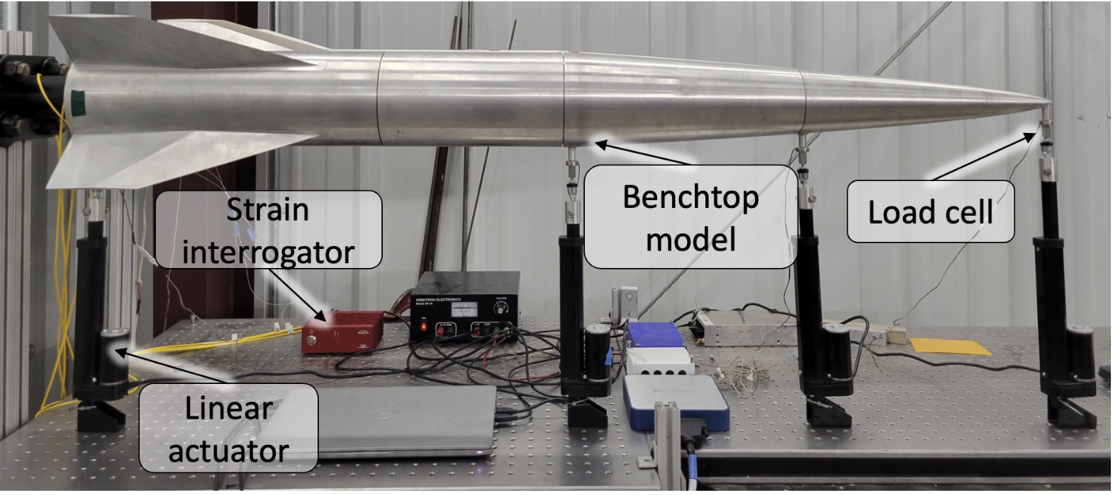
Case Study: Initial Concept 3X
2 stage hypersonic vehicle used as a benchmark for high-fidelity CFD simulations
This project is part of the NASA/AFOSR ULI program
The main objective of this project is to implement a scientific ML algorithm that can predict vehicle deformation, aerodynamic load, and thermal load by using a network of internal sensors

Slide 17
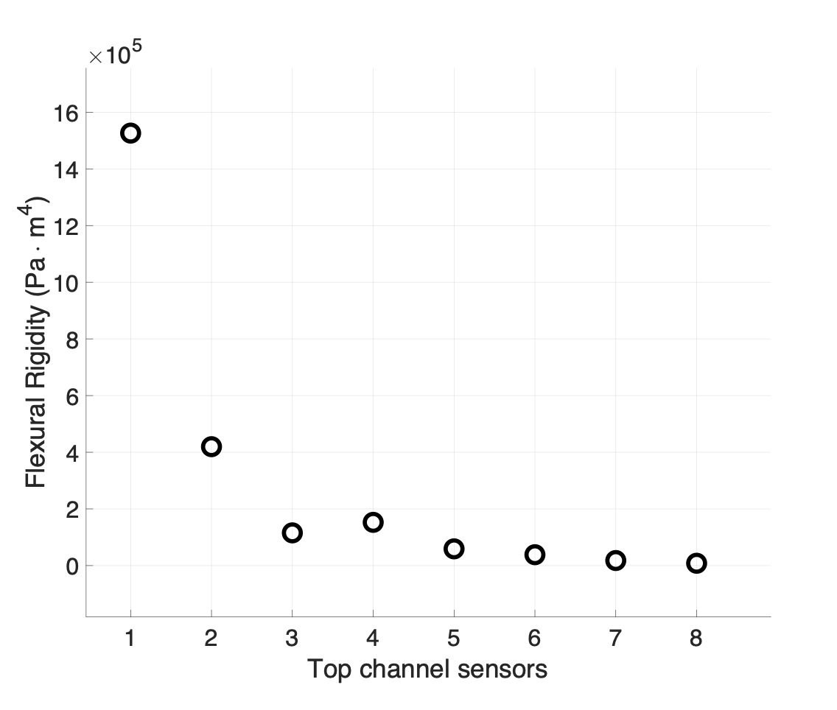
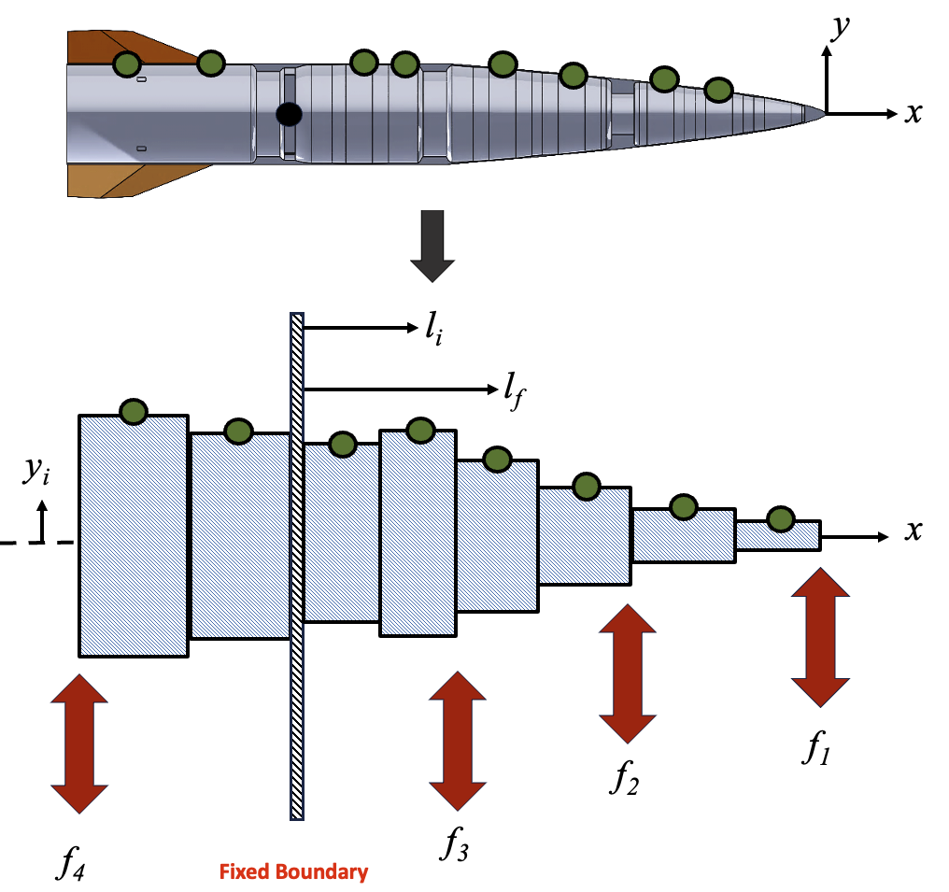
Simplifying IC3x as a Beam Model
A beam model can be created based on the flexural rigidity of the sensor’s location.
This simplification allows the use of Euler-Bernoulli Beam equation to calculate strain

Slide 18
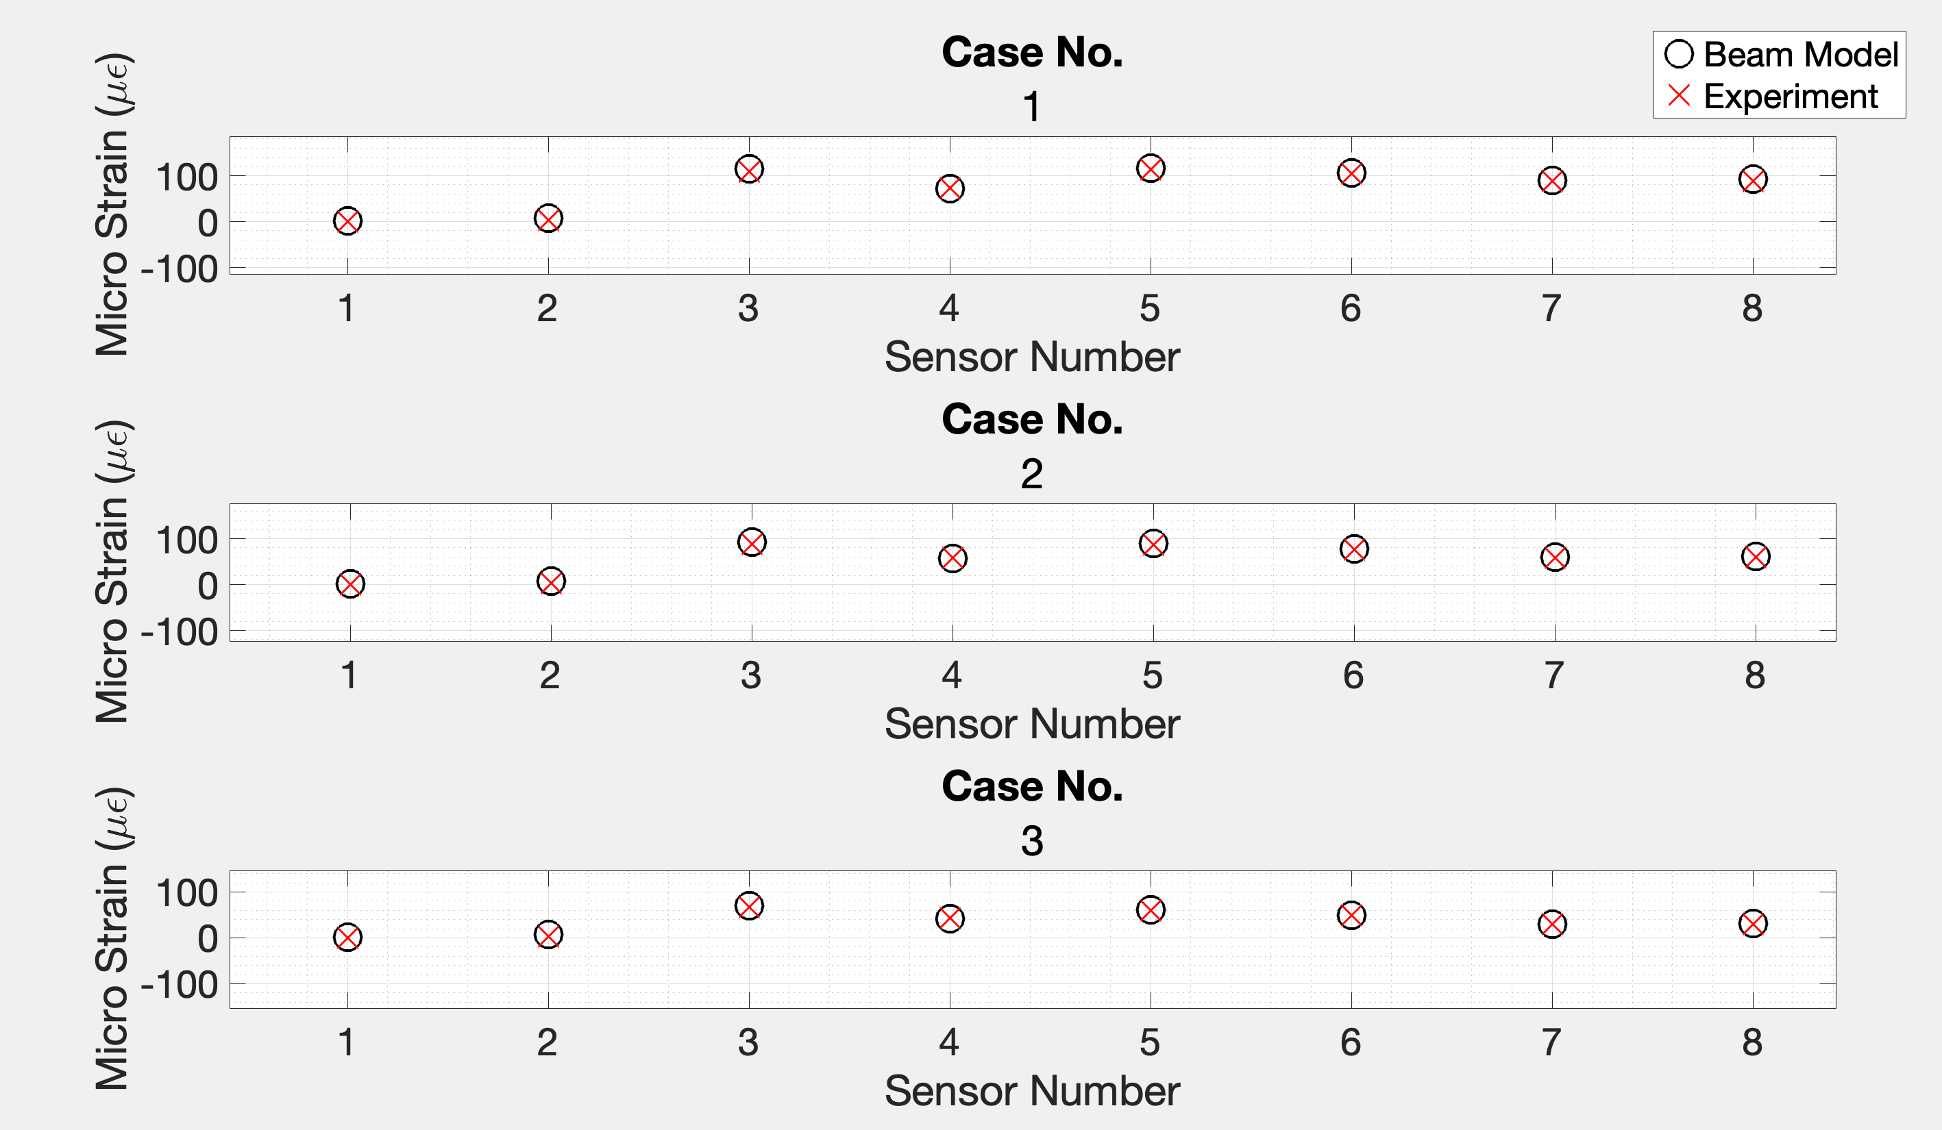
Simplifying IC3x as a Beam Model

Slide 19
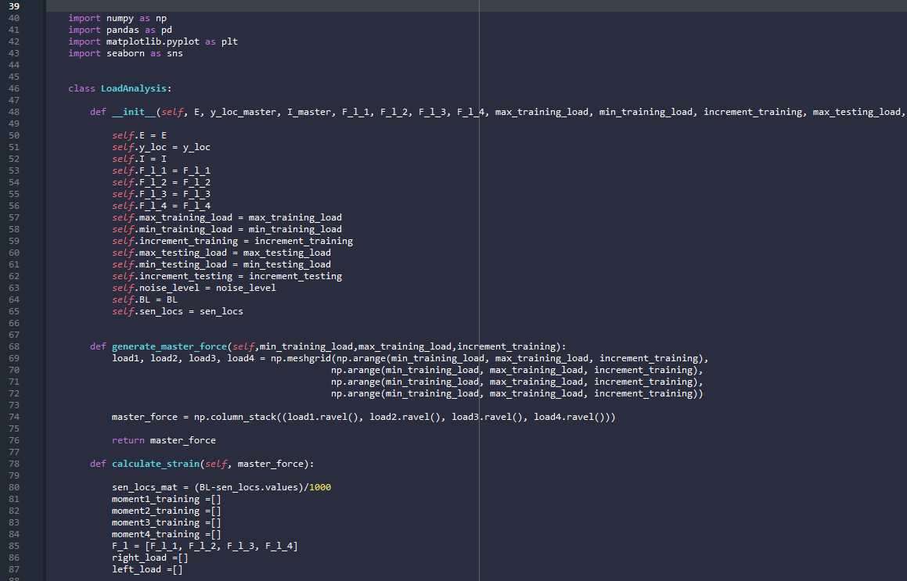
Demonstration
https://github.com/brandoncruz122/Load-Predictor

Slide 20
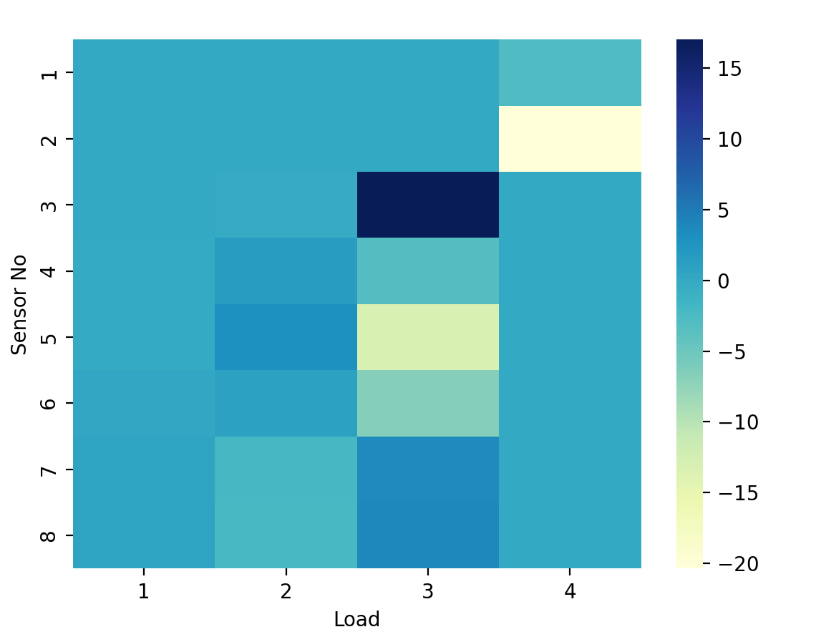
Influence Coefficient Matrix

Slide 21
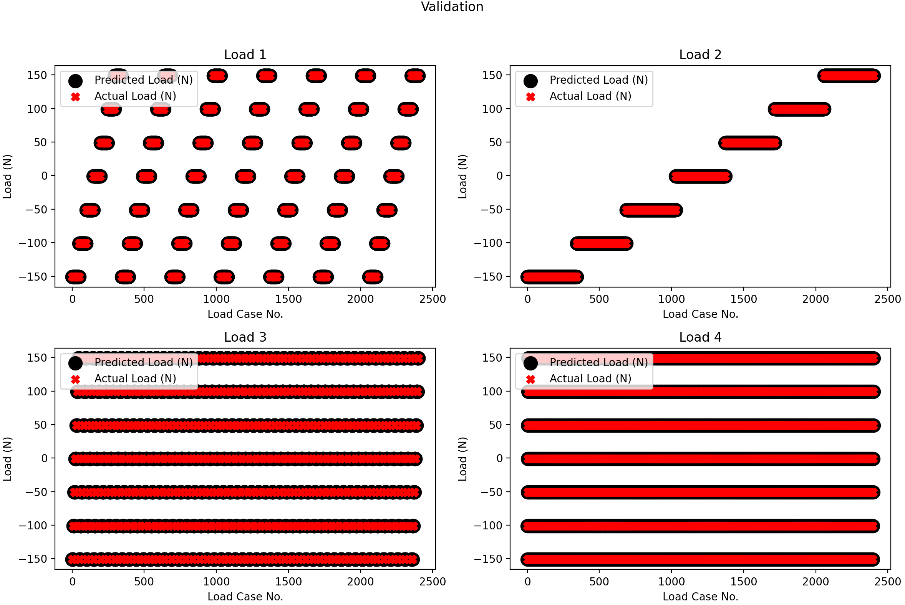
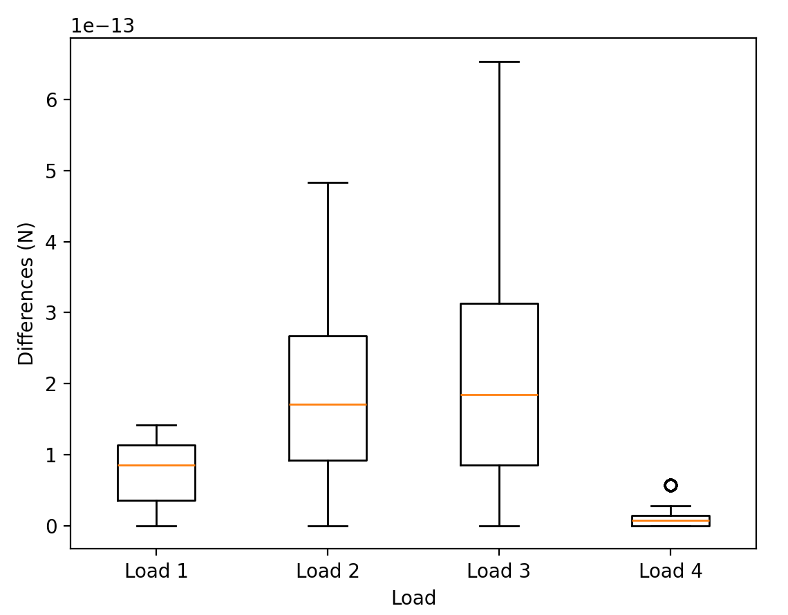
Validation

Slide 22
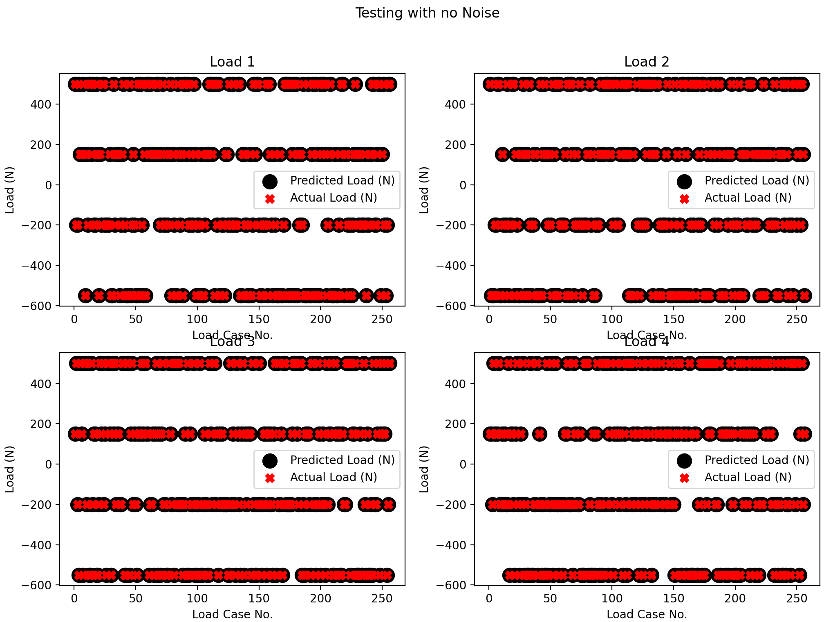
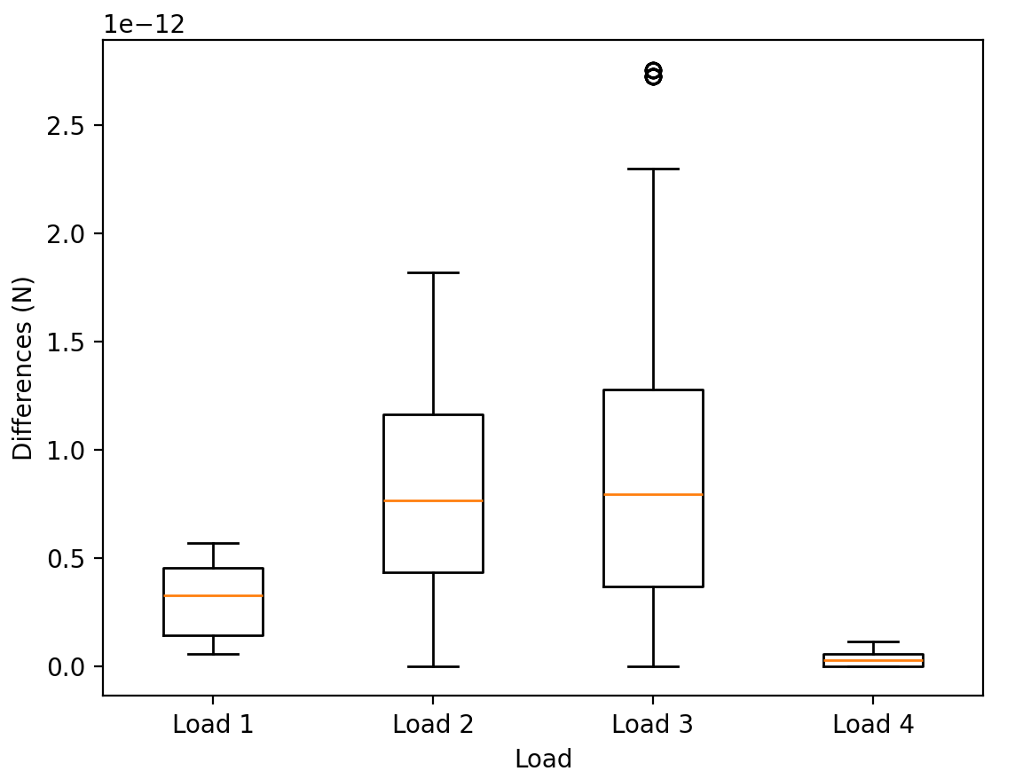
Test (No-Noise)

Slide 23
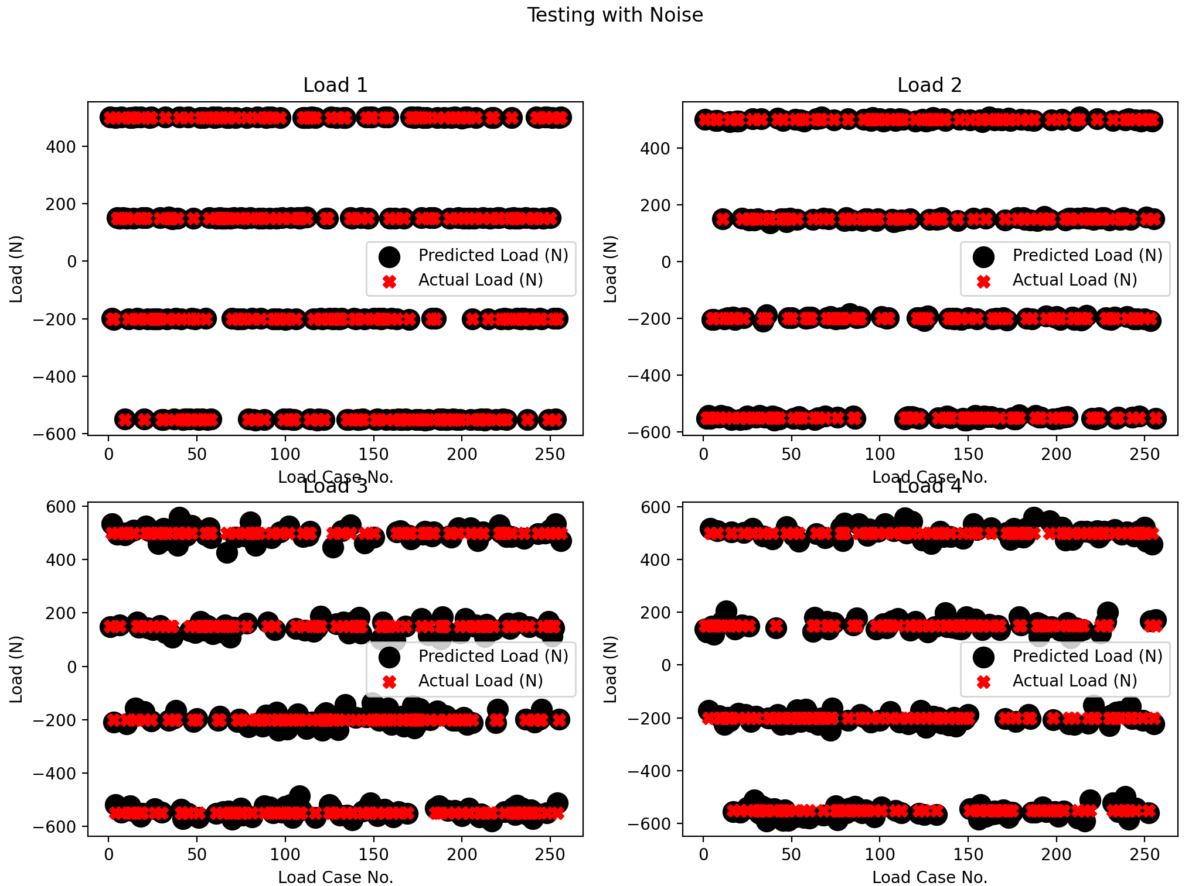
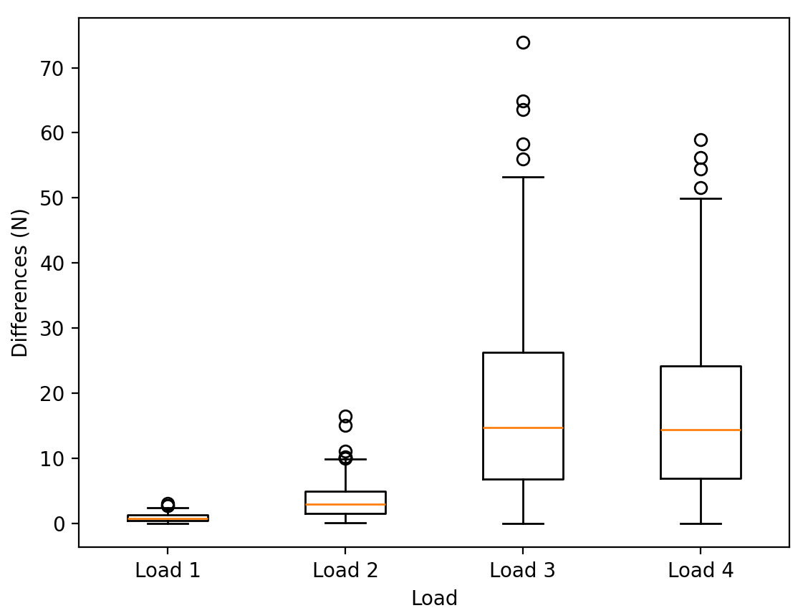
Test (Noise)

Slide 24
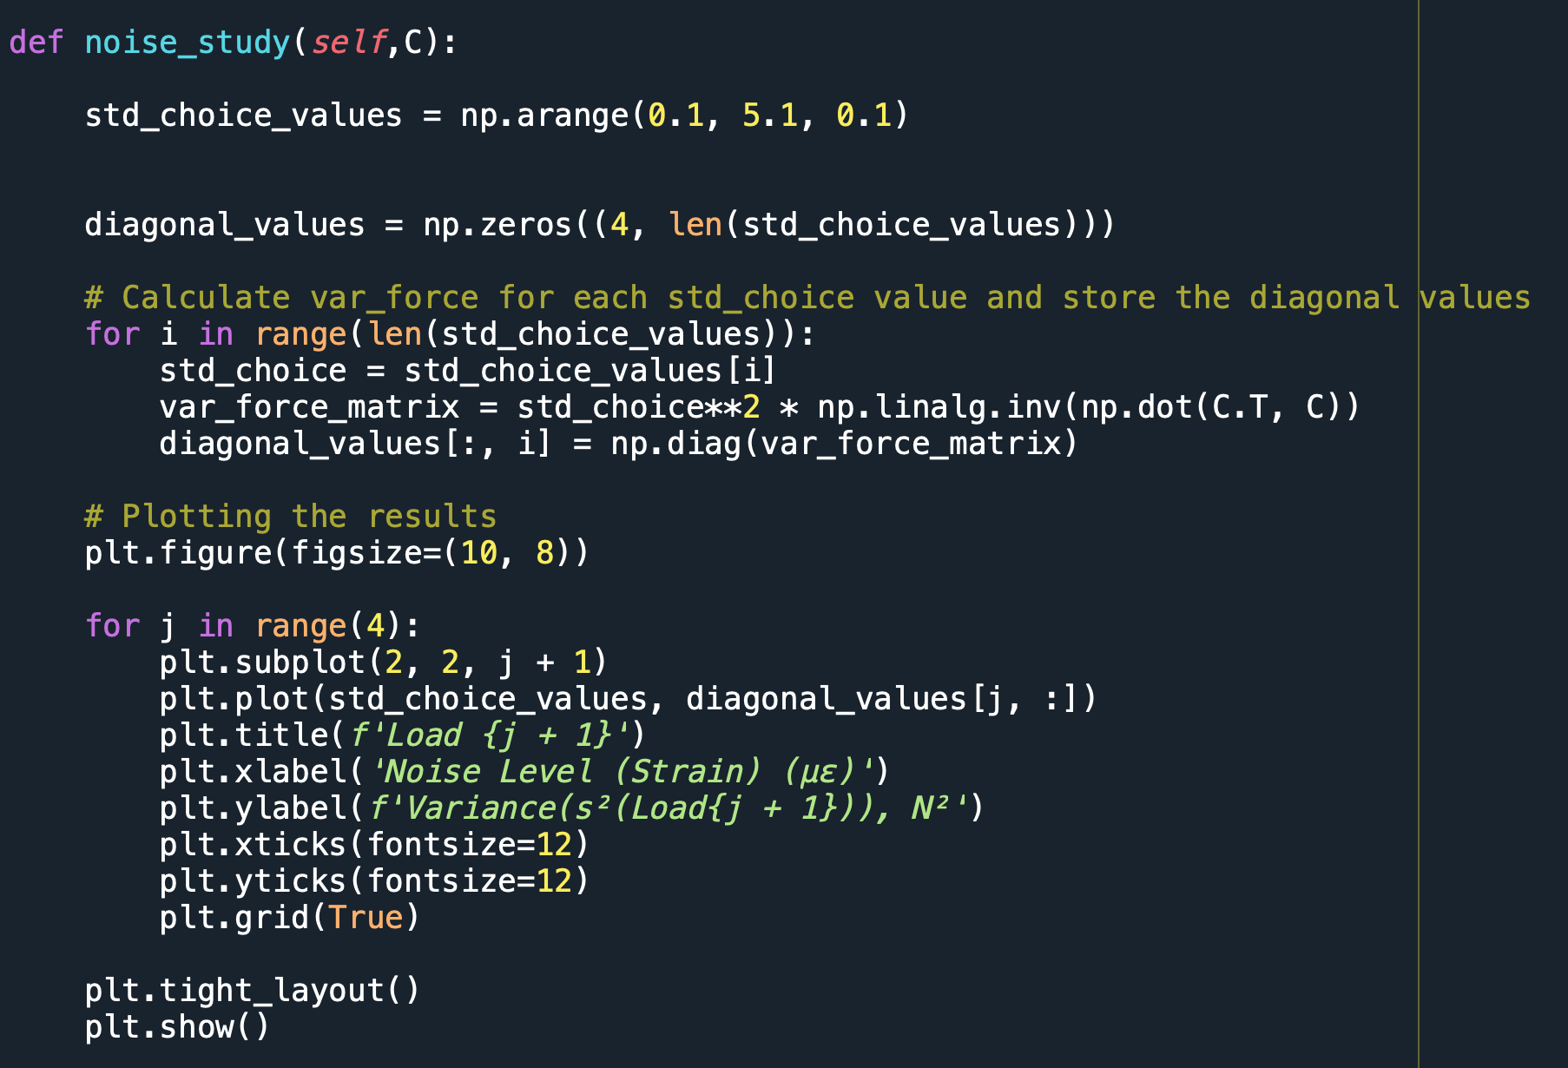
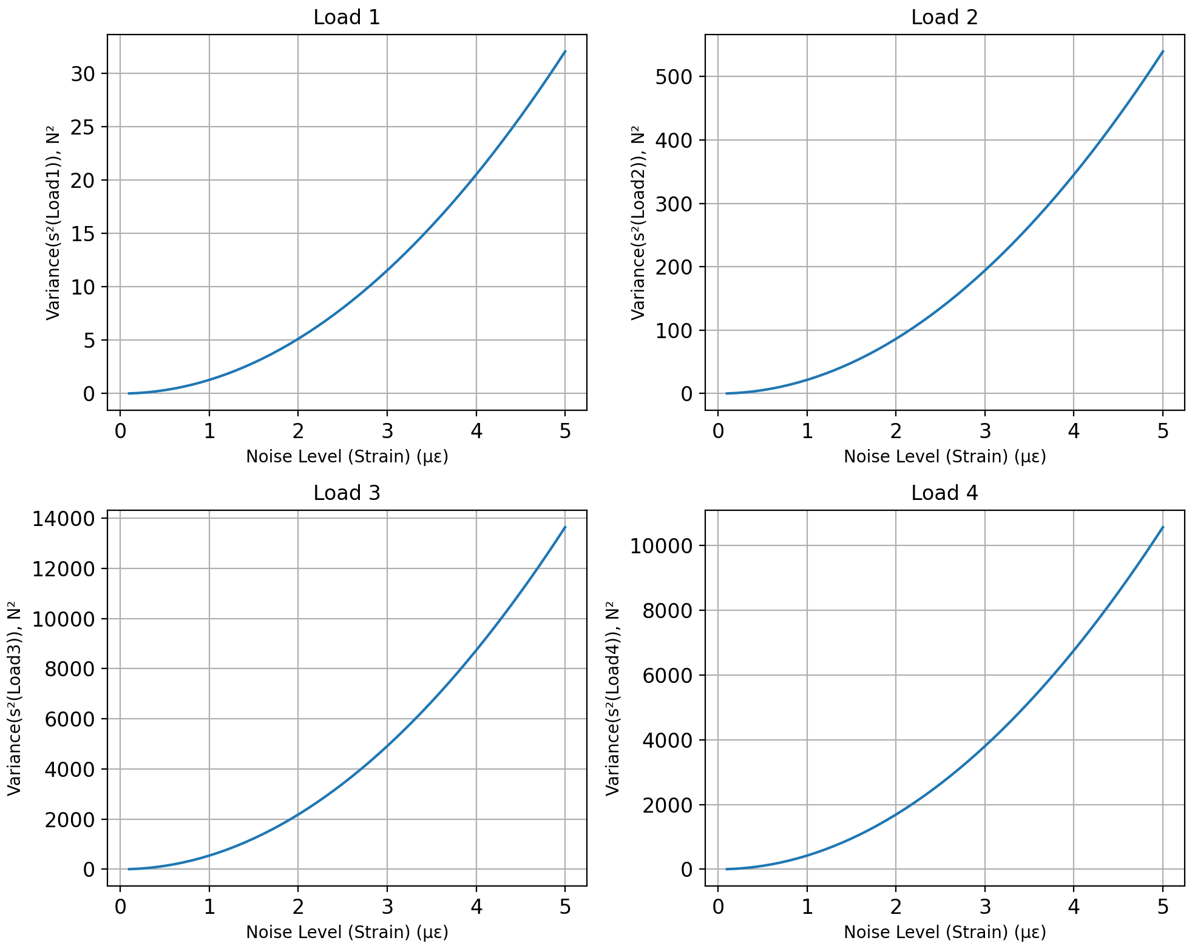


Noise-Study
$$\left[s^{2}\left(f\right)\right]=σ^{2}{\left[C^{T}⋅C\right]}^{−1}$$
Define the Variance-Covariance matrix of
$σ=noise level$
$force,f={\left[s^{2}\left(f\right)\right]}_{m×m}$

Slide 25
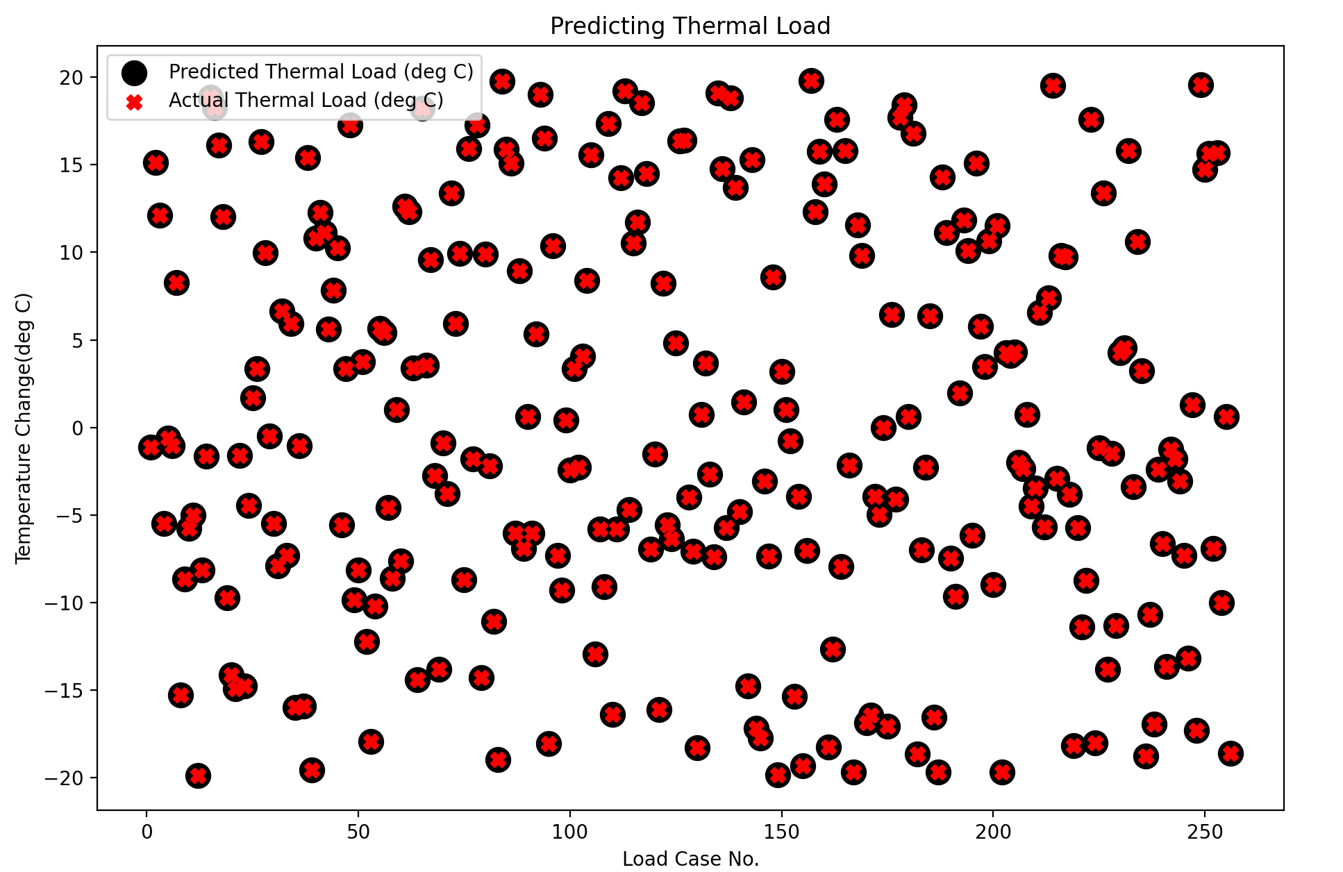
Temperature Prediction

Slide 26

Effect of moving $f_{3}$ by 30 cm

Slide 27
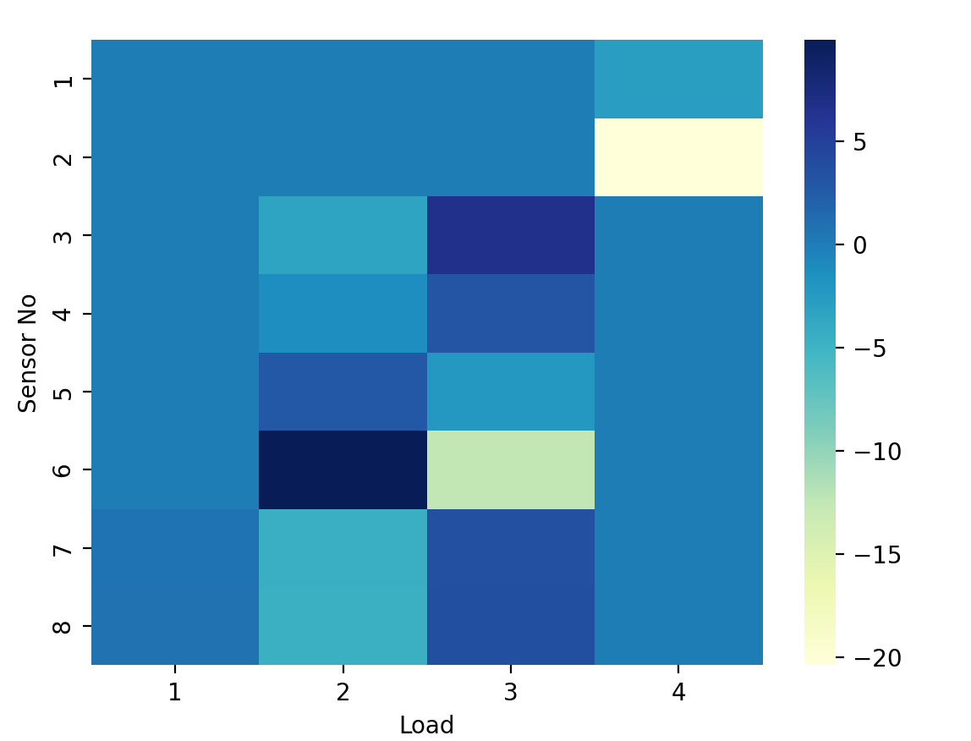
Effect of moving $f_{3}$ by 30 cm

Slide 28
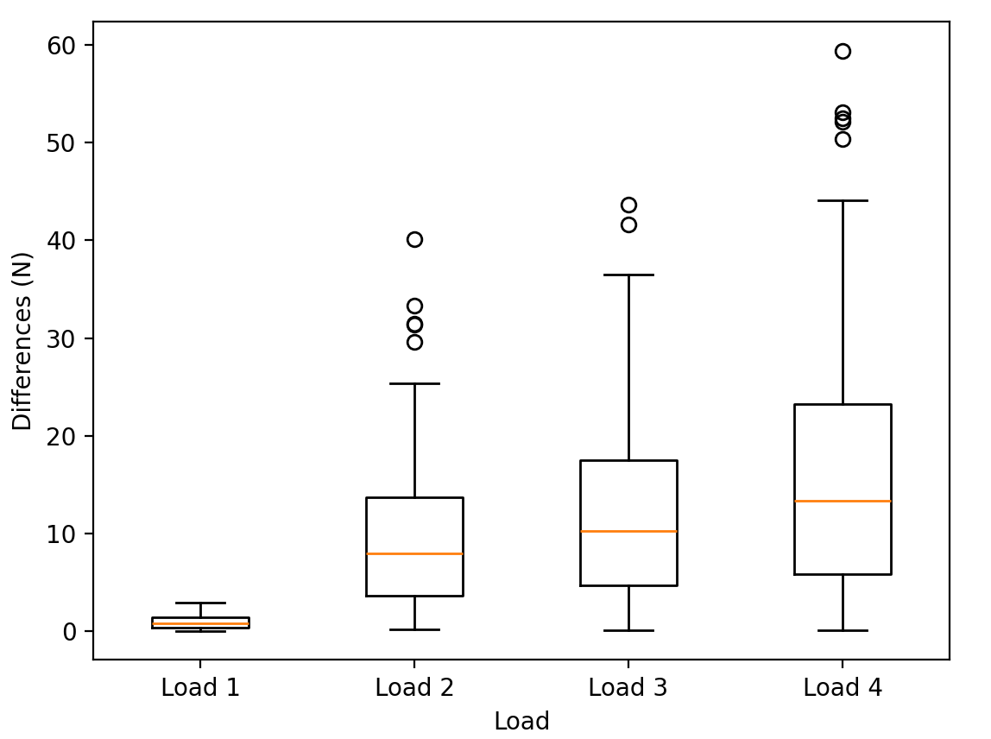
Effect of moving $f_{3}$ by 30 cm

Slide 29
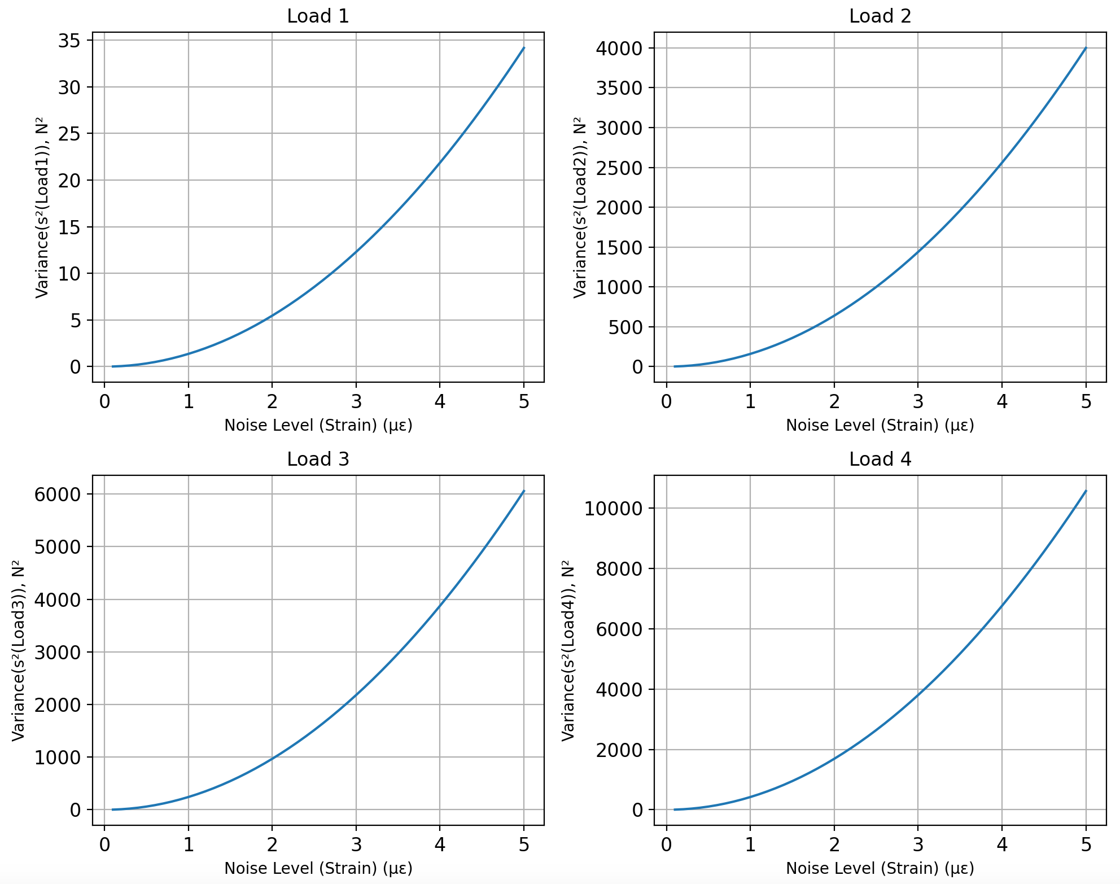
Effect of moving $f_{3}$ by 30 cm

Slide 30
Limitations and Future Work
This technique is restricted to the linearly elastic structure
Users can only apply up to 4 points loads
The next version will incorporate distributed loading conditions in addition to multiple-point loads.
The structure has to be clamped, i.e. no free-free boundary condition.
Current algorithm only works in static case
The next version would include time-varying loads and inertial component to conduct structural dynamic studies

Slide 31
Conclusion
We have successfully made and trained a ML model to predict applied loads on a model
We have added a GUI to ease user workflow
We have validated the model using the test data sets and have found good agreement between predictions and results

Slide 32
References
Python, Real. GUI Programming With PyQt (Learning Path) – Real Python. https://realpython.com/learning-paths/pyqt-gui-programming/. Accessed 15 Nov. 2023.
Yang, Haitao, et al. “Automatic Strain Sensor Design via Active Learning and Data Augmentation for Soft Machines.” Nature Machine Intelligence, vol. 4, no. 1, Jan. 2022, pp. 84–94. www.nature.com, https://doi.org/10.1038/s42256-021-00434-8.
freeCodeCamp.Org. https://www.freecodecamp.org/learn/machine-learning-with-python. Accessed 15 Nov. 2023.
Seaborn. https://www.w3schools.com/python/numpy/numpy_random_seaborn.asp. Accessed 15 Nov. 2023.

Slide 33
Thank you Aditya Panigrahi Brandon Cruz Spenser Stark

